Slide 1

FUNCTIONAL programming
Why should you care?

Slide 2
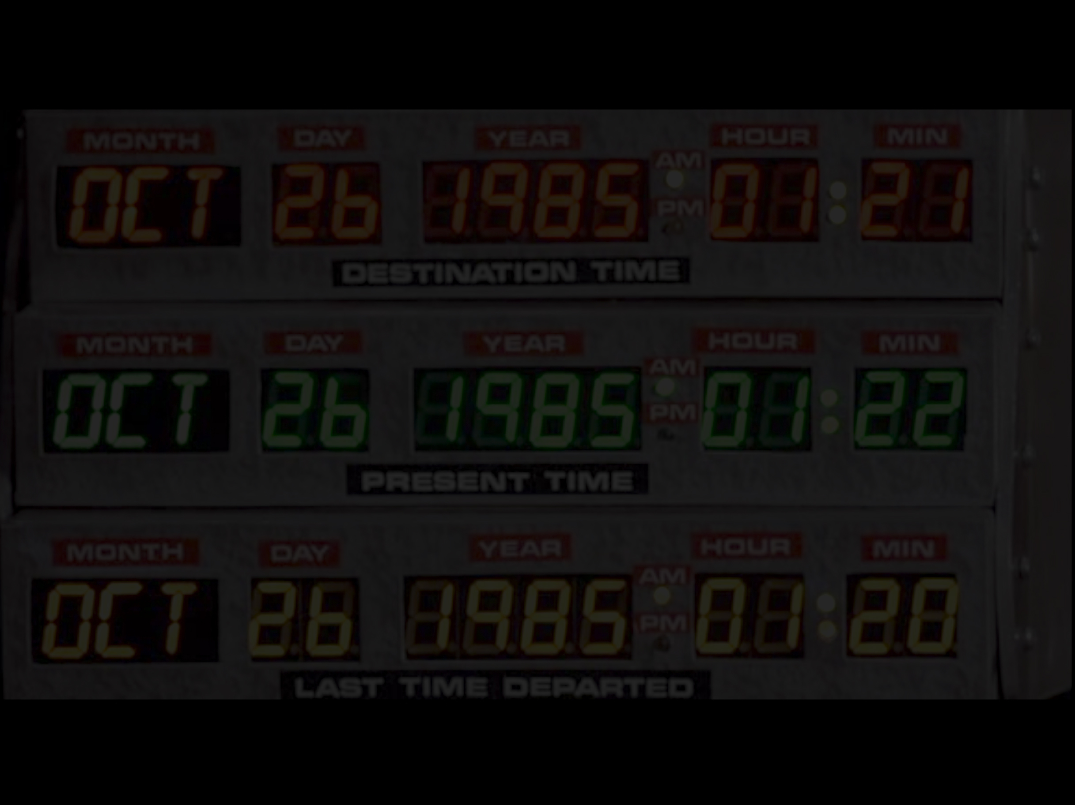
MOTIVATION for this talk
Before we start…

Slide 3
SEMI-FORMAL definition
Before we start…

Slide 4

AGENDA
What makes FP relevant?
Features of FP (some present in JS)
CODE!

Slide 5
fp is relevant FOR 3 REASONS

Slide 6

hipster

Slide 7
hipster
Closures
Generics
Garbage collection
Code as data
Monads
Lazy evaluation
Pattern Matching
Lexical Scope

Slide 8
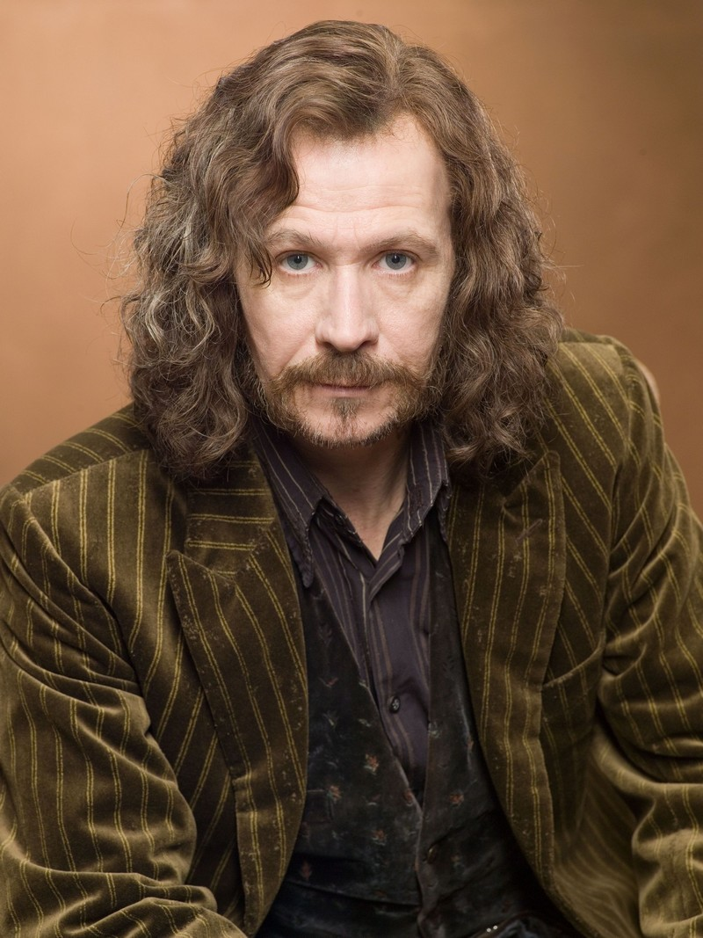

debunks miths

Slide 9
debunks miths
Recursion
Mutation

Slide 10

debunks miths

Slide 11


debunks miths
Rick Hickey
(clojure)

Slide 12
scalability
B M H

Slide 13
scalability
Buy More Hardware

Slide 14
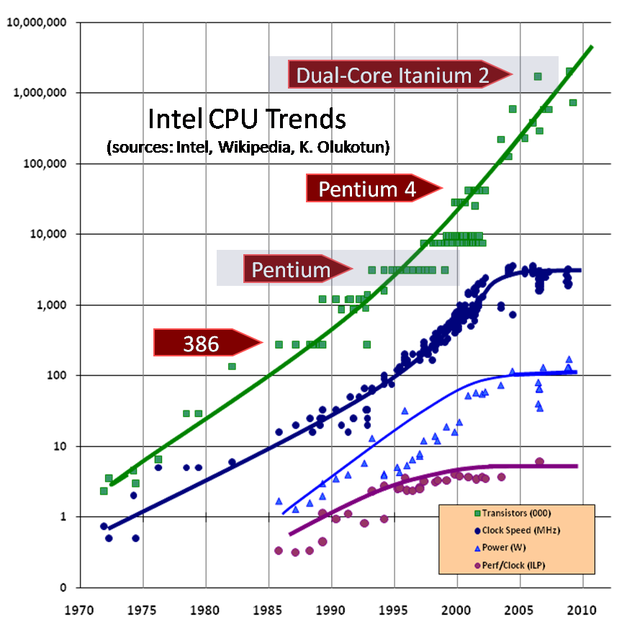
scalability

Slide 15
scalability
Launch More Instances

Slide 16
fp in its pure state (AND IN JAVASCRIPT)

Slide 17
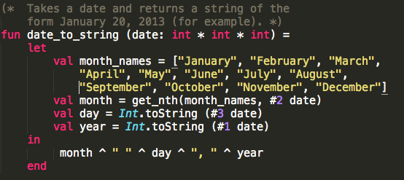
lexical scope

Slide 18
lexical scope
var x = 2, y = 3;
function someAdd() {
var x = 4;
return x + y;
}
someAdd();

Slide 19
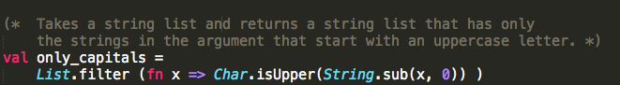
closures

Slide 20
closures
http.get(“www.google.com, function (res) {
....
res.on('data', function(chunk) {
...
}).on('end', function() {
.....
});

Slide 21
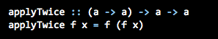
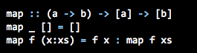
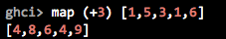
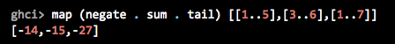
first order functions

Slide 22
first order functions
fn.apply
_.map…
_.compose

Slide 23
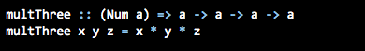
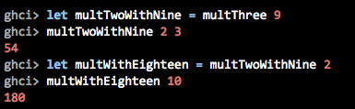
currying

Slide 24
currying
_.partial…

Slide 25
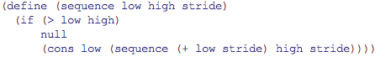
code as data

Slide 26
code as data
{"menu": {
"id": "file",
"value": "File",
"popup": {
"menuitem": [
{"value": "New", "onclick": "CreateNewDoc()"},
{"value": "Open", "onclick": "OpenDoc()"},
{"value": "Close", "onclick": "CloseDoc()"}
]
}
}}

Slide 27
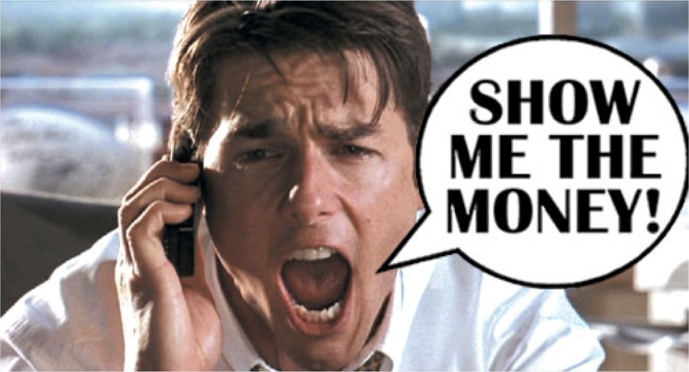

Slide 28
conclusions

Slide 29
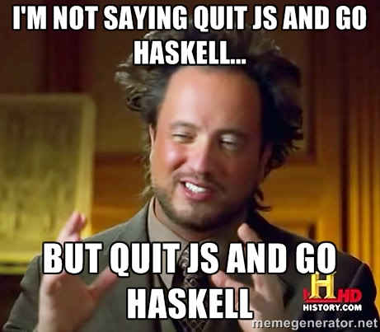

Slide 30
languages
Static: ML (primero), Haskell
Dynamic: Racket, Clojure, Scheme (i.e. a Lisp)
Scala???

Slide 31
libraries
Q (https://github.com/kriskowal/q)
RSVP (https://github.com/tildeio/rsvp.js)
FutureJS (https://github.com/FuturesJS/FuturesJS)
Promised-io (https://github.com/kriszyp/promised-io)
Bacon(https://github.com/baconjs/bacon.js)
Fn.js(http://eliperelman.com/fn.js/)
Wu (http://fitzgen.github.io/wu.js/)
Fnky (https://github.com/leoasis/fnky)
Prelude (http://preludels.com/)

Slide 32
watch and read
“Hey Underscore, you’re doing it wrong”
http://www.youtube.com/watch?v=m3svKOdZijA
“How to survive asynchronous programming in JS”
http://www.infoq.com/articles/surviving-asynchronous-programming-in-javascript
“Callbacks are imperative, Promises are Functional”
https://blog.jcoglan.com/2013/03/30/callbacks-are-imperative-promises-are-functional-nodes-biggest-missed-opportunity/
“Promises/A spec”
http://wiki.commonjs.org/wiki/Promises/A

Slide 33
topics
Monads
Currying/Partial/Compose/Point-free
Benefits of no mutation
Promises/Futures
Subtyping/Generics
Lazyness
Libreries
Native support in JS

Slide 34
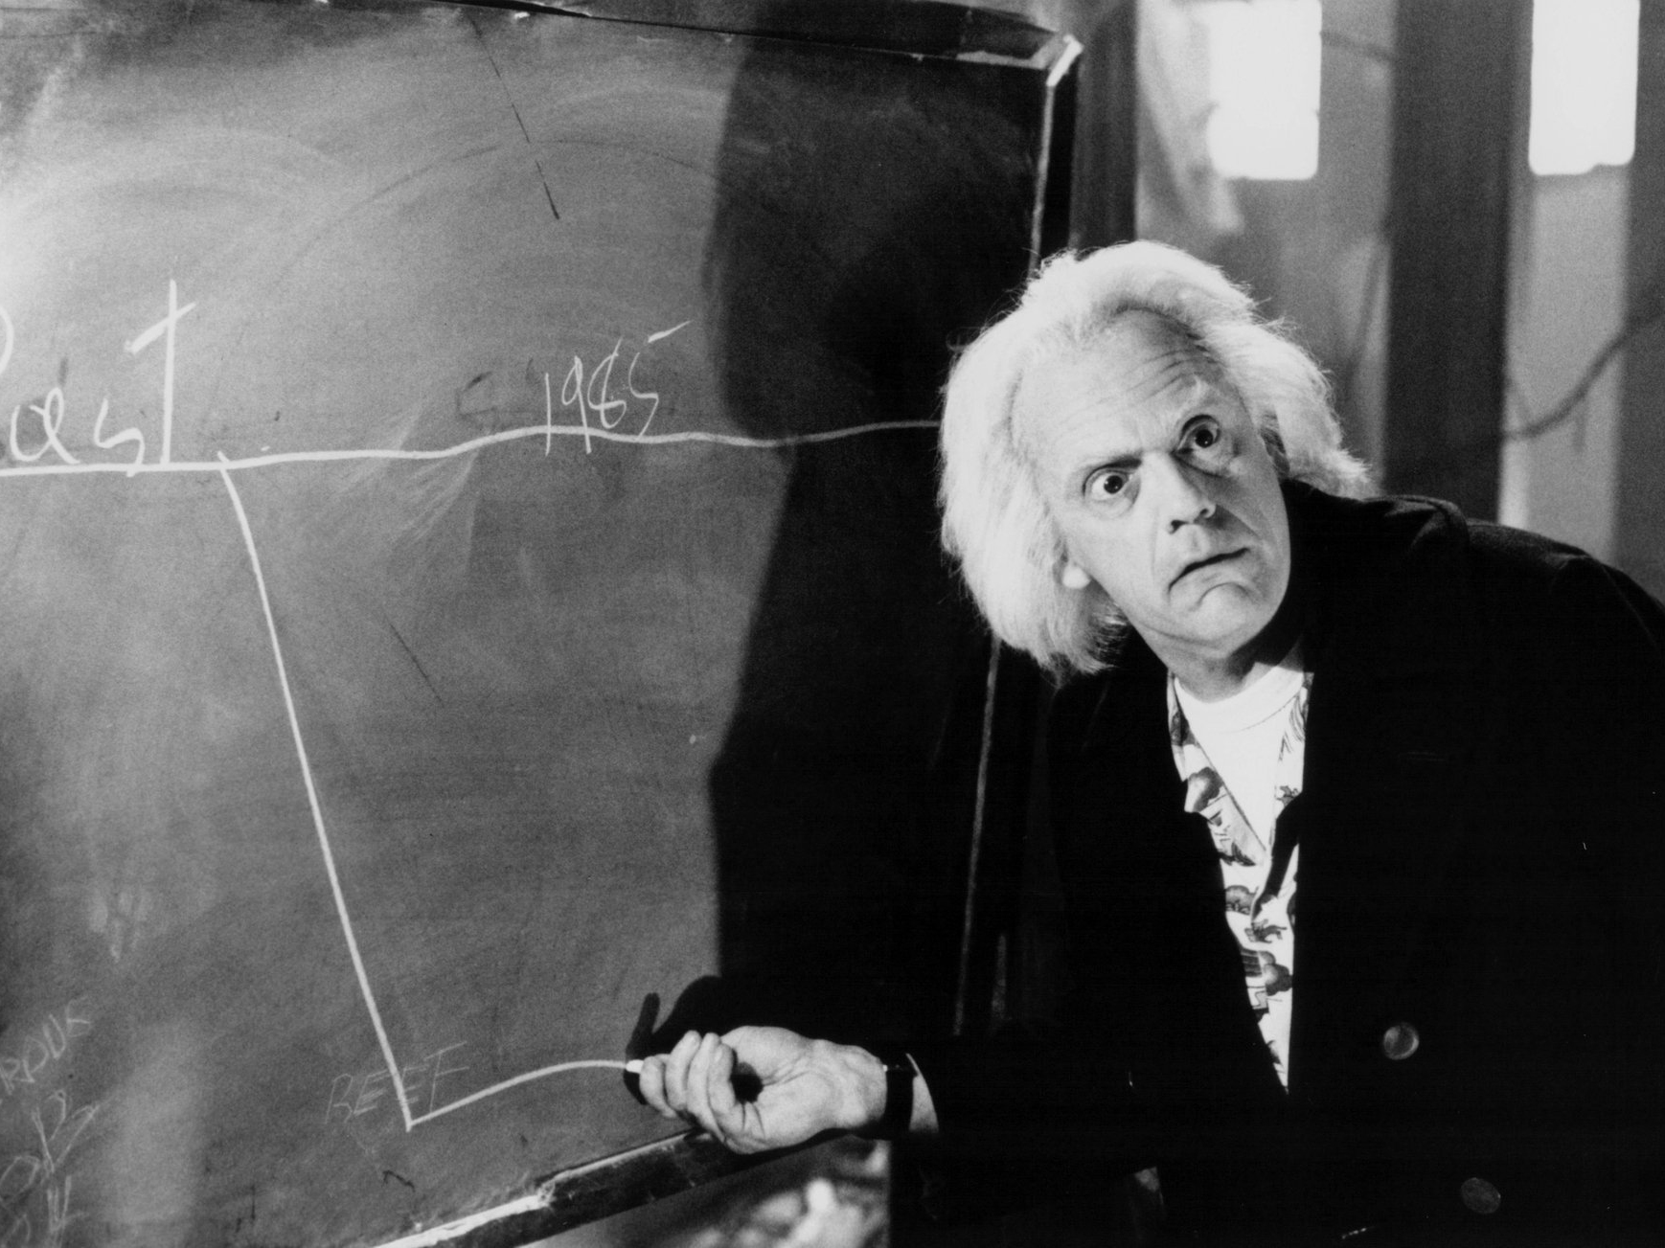

Slide 35
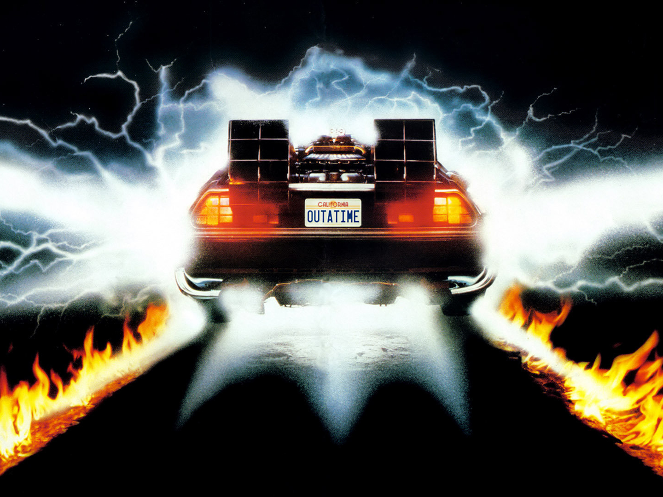
github.com/holden-caulfield/
@jpsaraceno
THANKS!

